Slide 1

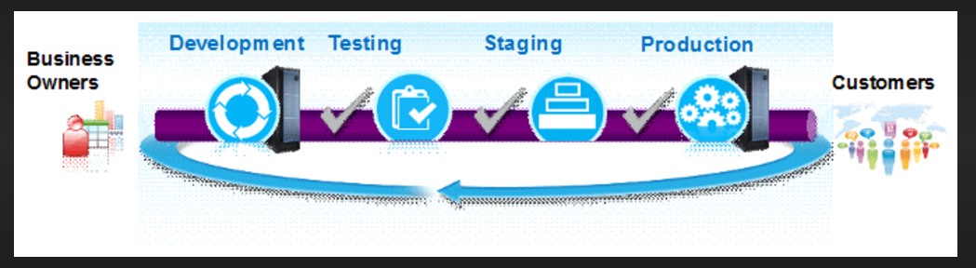
Continuous Integration, Delivery and Deployment PIPELINE

Slide 2


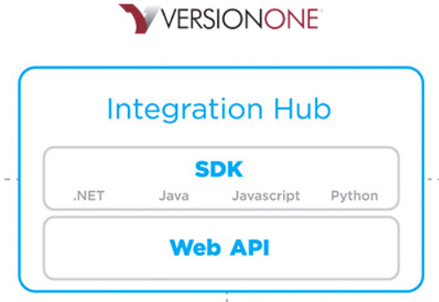






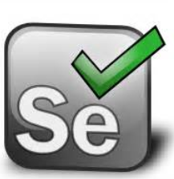
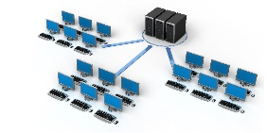
Continuous Integration, Delivery and Deployment Architecture Diagram
Build Sites
Communication Methods
Selenium Regression Testing

Slide 3
Continuous Integration, Delivery and Deployment STEPS
STEP 1
Developer commit code in SVN in DEV and enter specific string in SVN log message
STEP 2
Automation creates VersionONE Parent Deployment ticket and links VersionONE UserStories
STEP 3
Automation transitions VersionONE Parent Deployment and UserStories ticket in correct STATUS
STEP 4
Automated Testing trigger via Automation, transition VersionONE User Stories in correct STATUS based on Pass | Fail and communicate results to all stakeholders via Trillian | Email | Mobile |Confluence or other method preferred.
STEP 5
QA performs testing and transition UserStories in correct STATUS, and automation transition VersionONE Deployment ticket in correct STATUS
STEP 6
Automation transition VersionONE Deployment ticket and VersionONE UserStories if necessary in STG and/or PROD and send communication to all stakeholders via Trillian | Email | Mobile | Confluence or any method preferred.
STEP 7
Validator close the VersionONE Deployment ticket and VersionONE UserStories if necessary.
Automation can also close all VersionOne UserStories ticket if VersionONE Parent ticket is closed.

Slide 4
Continuous Integration, Delivery and Deployment Flowchart
BEGIN
Developer SVN SmartCommit
V1 Parent Deployment ticket created and V1 User Stories link in V1 Parent Deployment ticket
Developer Deploy Code in QA
QA creates a defect, Automation closes the original User Story and de-link from VersionONE Parent Deployment Issue
QA Testing Pass | Fail
Automation transition V1 Parent Deployment ticket in correct STATUS. Ready-for-Stage and/or Ready-for-Prod
Fail
Pass
Automation can rollback
Fail
Fail
Fail
Validation Pass | Fail
Developer deploys in STG and/or PROD based on STATUS of V1 Parent Deployment ticket
Fail
Pass
END
Validator close VI Parent Deployment ticket

Slide 5
Continuous Integration, Delivery and Deployment Status/s
VersionONE Parent Deployment Workflow no manual transition of status/s required exception of Closed ticket Automationn can be accomplish via configuring listeners | events | triggers | actions in SVN | VersionONE | SERVICENOW
Open
Request-to-DEV
DEV-In-Progress
DEV-Installed
DEV-Failed
Ready-for-QA
Request-to-QA
QA-In-Progress
QA-Installed
QA-Failed
Ready-for-STG
Request-to-STG
STG-In-Progress
STG-Installed
STG-Failed
Ready-for-Prod
Request-to-Prod
Prod-In-Progress
Prod-Installed
Prod-Failed
Reopen
Closed

Slide 6
Continuous Integration, Delivery and Deployment resources required
Universal userid | password that can login to JENKINS | SVN | VERSIONONE | SERVICENOW | Methode | Selenium Servers | Confluence via API
VersionONE add-on ALM Connect to integrate JIRA | Eclipse | SERVICENOW | JENKINS | AWS
Faruq Hunter Project Management Office Interaction for VERSIONONE, grant proper permission to create and update items in Project/s.
Infrastructure Team open firewall, configure two-way communication JENKINS | SVN | VERSIONONE | SERVICENOW | Methode | Selenium Servers | Confluence, allow API to harmonize communication/s between application/s.
Sandbox/Test environment for Production
Rob Combs Newspaper team involvement and sign-off regarding Continuous Integration/Deployment Process
Development, QA, Manager, Director input and/or support/sign-off to achieve Continous Integration/Deployment
Access to servers SERVICENOW, SVN, VERSIONONE, CONFLUENCE, DEV, QA, STG, PROD
Integrate Confluence and VERSIONONE | SERVICENOW

Slide 7
Continuous Integration, Delivery and Deployment Release Change Management
Automation create SERVICENOW ticket based upon V1 Parent Deployment ticket status
Integrate Confluence and VersionONE
Create custom fields in VersionONE and SERVICENOW
Create Confluence dashboard in DEV | QA | STG | PROD to identify release
Create PHP Page show release versions side-by-side DEV | QA |STG | PROD
Create awesome reports/dashboards VersionONE/SERVICENOW to display build | deployment | release | change metrics

Slide 8
Continuous Integration/Deployment Advantages
Continuous Integration, Delivery and Deployment Advantages
Elimination Build Engineer/s executing any deployments
Deployments become much less error-prone and much more repeatable
Eliminates blind spot. At all times you know where you are, what works, what doesn't, the outstanding bugs you have in your system.
Gain a measurable competitive edge by reducing the time from implementation to deployment.
Helps to mitigate the project risk.
Release can happen more frequently
Estimate Project Cost accurately
Improving the quality of your code. You can achieve a better quality product application or website project.
Making your developers more efficient. You can receive “more bang for your buck” and narrow down the cost of software projects.
Showing your prowess in your market. You let everyone know that you have the best practices that produce the highest quality work.
Increase visibility which enables greater communication
Spend less time debugging and more time adding features
Reduce integration problems allowing you to deliver software more rapidly

